Slide 1
Special review
By Gabriel Birgand

Slide 2
Global burden of bacterial antimicrobial resistance in 2019: a systematic analysis
Objective: first global estimates of the burden of bacterial AMR covering an extensive set of pathogens and pathogen–drug combinations using consistent methods for both counterfactual scenarios
Methods:
All available data and builds on death and incidence estimates for different underlying conditions from the Global Burden of Diseases (n=369), Injuries (n=204), and Risk Factors Study (GBD) 2019
Data from published studies and collaborators on the Global Research on Antimicrobial Resistance project, GBD Network, and other data providers
Estimation of burden attributable to AMR
12 major infectious syndromes
23 bacterial pathogens,
18 drug categories or combinations of drugs for which there is resistance, and 88 pathogen–drug combinations
Model all-age and age-specific deaths and disability-adjusted life-years (DALYs) for 204 countries and territories, and we present aggregated estimates for 21 GBD regions, seven GBD super-regions, and globally in 2019
Lancet
https://doi.org/10.1016/ S0140-6736(22)00087-3

Slide 3
Global burden of bacterial antimicrobial resistance in 2019: a systematic analysis
Methods:
1st scenario: all drug resistant infections are replaced by susceptible infections; estimated only deaths and DALYs directly attributable to resistance
2nd scenario: all drug-resistant infections are replaced by no infection; estimated all deaths and DALYs associated with resistant infection.
Number of deaths where infection plays a role: GBD 2019 cause of death, number of deaths by age, sex, and location for which either the underlying cause of death was infectious or for which the pathway to death was through sepsis.
Data for multiple causes of death covering 121 million deaths, 5·54 million hospital discharges with discharge status of death, and 264 000 records of multiple causes of death linked to hospital records from ten countries and territories, as well as 870 deaths from Child Health and Mortality Prevention Surveillance
Logistic regression models to predict the fraction of sepsis occurring in each underlying cause of death
We then multiplied the fraction of sepsis predicted from the logistic regression models onto GBD causespecific mortality estimates to determine the mortality envelope for our analysis.
Lancet
https://doi.org/10.1016/ S0140-6736(22)00087-3

Slide 4
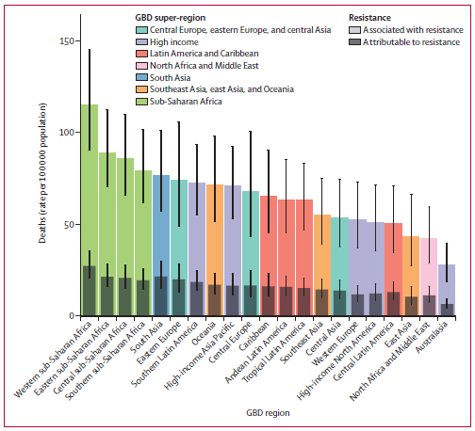
Global burden of bacterial antimicrobial resistance in 2019: a systematic analysis
Among the 21 GBD regions, Australasia had the lowest AMR burden in 2019,
6·5 deaths per 100 000 attributable to AMR
28·0 deaths per 100 000 associated with AMR.
Western sub-Saharan Africa had the highest burden,
27·3 deaths per 100 000 attributable to AMR
114·8 deaths per 100 000 associated with AMR.
5 regions had all-age death rates associated with bacterial AMR >75 per 100 000:
All four regions of sub-Saharan Africa and south Asia.
Although sub-Saharan Africa had the highest all-age death rate attributable to and associated with AMR, the % of all infectious deaths attributable to AMR was lowest in this super-region
Lancet
https://doi.org/10.1016/ S0140-6736(22)00087-3

Slide 5
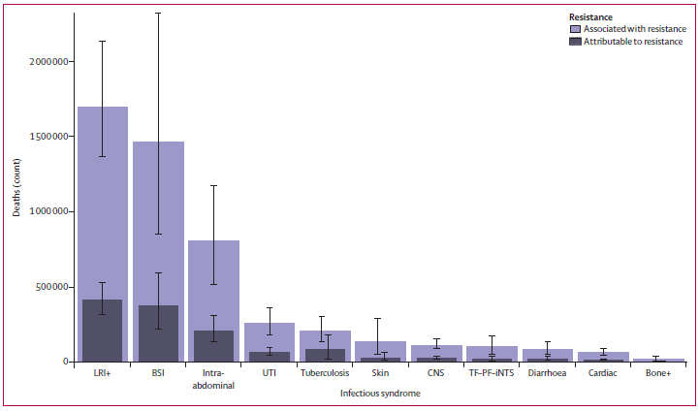
Global burden of bacterial antimicrobial resistance in 2019: a systematic analysis
Combined, lower respiratory and thorax infections, bloodstream infections, and intra-abdominal infections accounted for 78·8% (95% UI 70·8–85·2) of deaths attributable to AMR in 2019;
Lower respiratory infections alone accounted for more than 400 000 attributable deaths and 1·5 million associated deaths
Lancet
https://doi.org/10.1016/ S0140-6736(22)00087-3

Slide 6
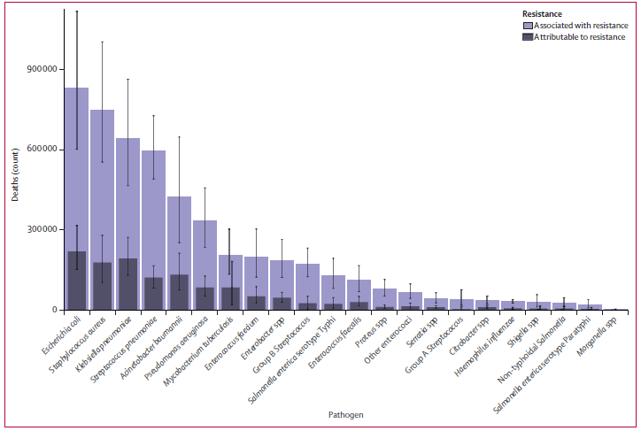
Global burden of bacterial antimicrobial resistance in 2019: a systematic analysis
6 pathogens each responsible for >250 000 deaths
E coli, S. aureus, K pneumoniae, S pneumoniae, A. baumannii, and P. aeruginosa,
Responsible for 929 000 of 1·27 million deaths attributable to AMR and 3·57 million of 4·95 million deaths
E coli responsible for the most deaths in 2019,
followed by K pneumoniae, S aureus, A baumannii, S pneumoniae, and M tuberculosis.
Lancet
https://doi.org/10.1016/ S0140-6736(22)00087-3

Slide 7
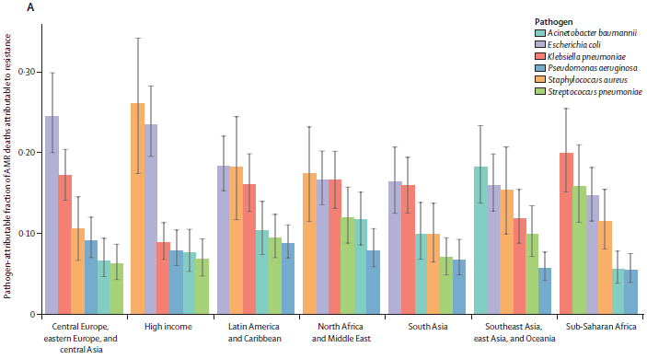
Global burden of bacterial antimicrobial resistance in 2019: a systematic analysis
In high-income super-region, Half of the fatal AMR burden was linked to S aureus (26·1% of deaths) and E coli (23·4%). In sub-Saharan Africa: S pneumoniae (15·9%), K pneumoniae (19·9%)
Lancet
https://doi.org/10.1016/ S0140-6736(22)00087-3

Slide 8
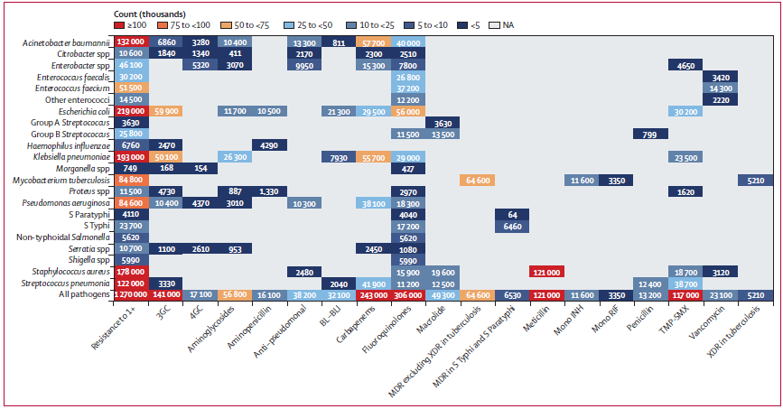
Global burden of bacterial antimicrobial resistance in 2019: a systematic analysis
MRSA: >100 000 deaths and 3·5 million DALYs attributable
6 pathogen–drug combinations each caused between 50 000 and 100 000 resistance-attributable
deaths :
MDR excluding XDR tuberculosis,
3GC-R E coli,
CP-Ab,
FQ-R K pneumoniae,
3GC-R K pneumoniae
Lancet
https://doi.org/10.1016/ S0140-6736(22)00087-3

Slide 9
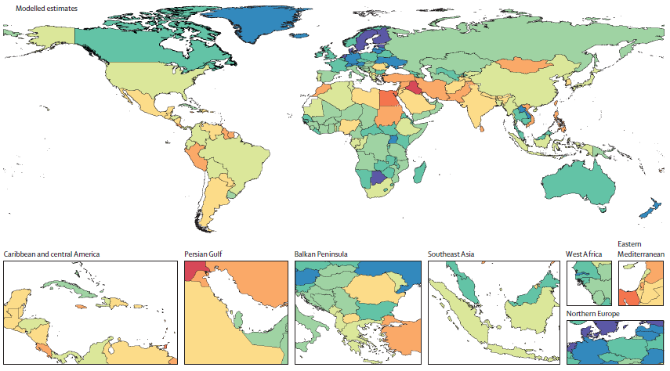
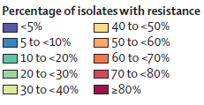
Global burden of bacterial antimicrobial resistance in 2019: a systematic analysis
MRSA
Lancet
https://doi.org/10.1016/ S0140-6736(22)00087-3

Slide 10
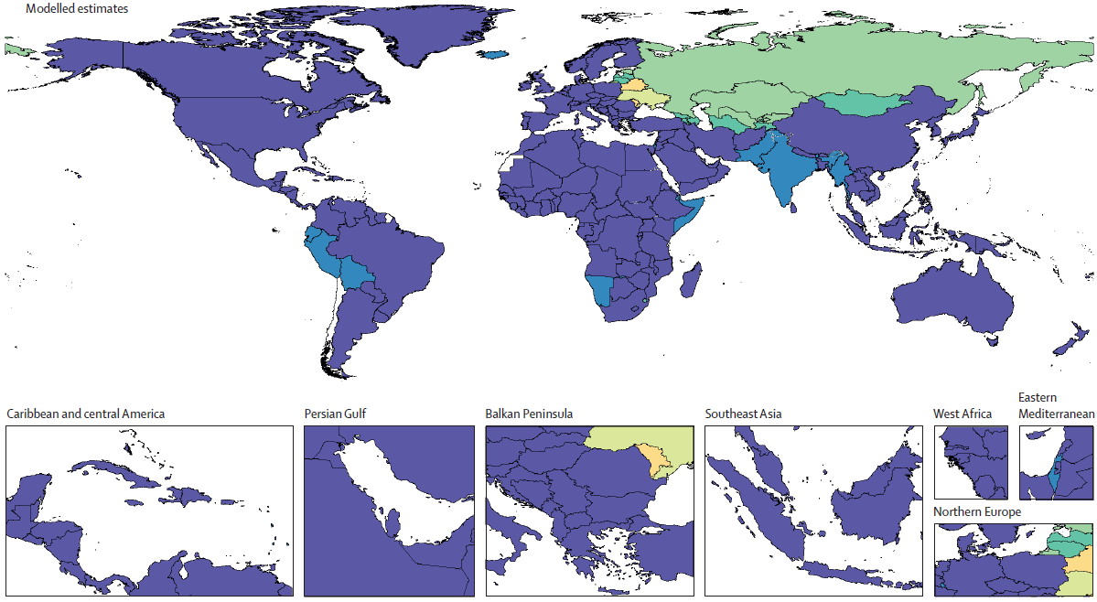
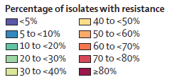
Global burden of bacterial antimicrobial resistance in 2019: a systematic analysis
Isoniazid and rifampicin co-resistant (excluding XDR) Mycobacterium tuberculosis
Lancet
https://doi.org/10.1016/ S0140-6736(22)00087-3

Slide 11
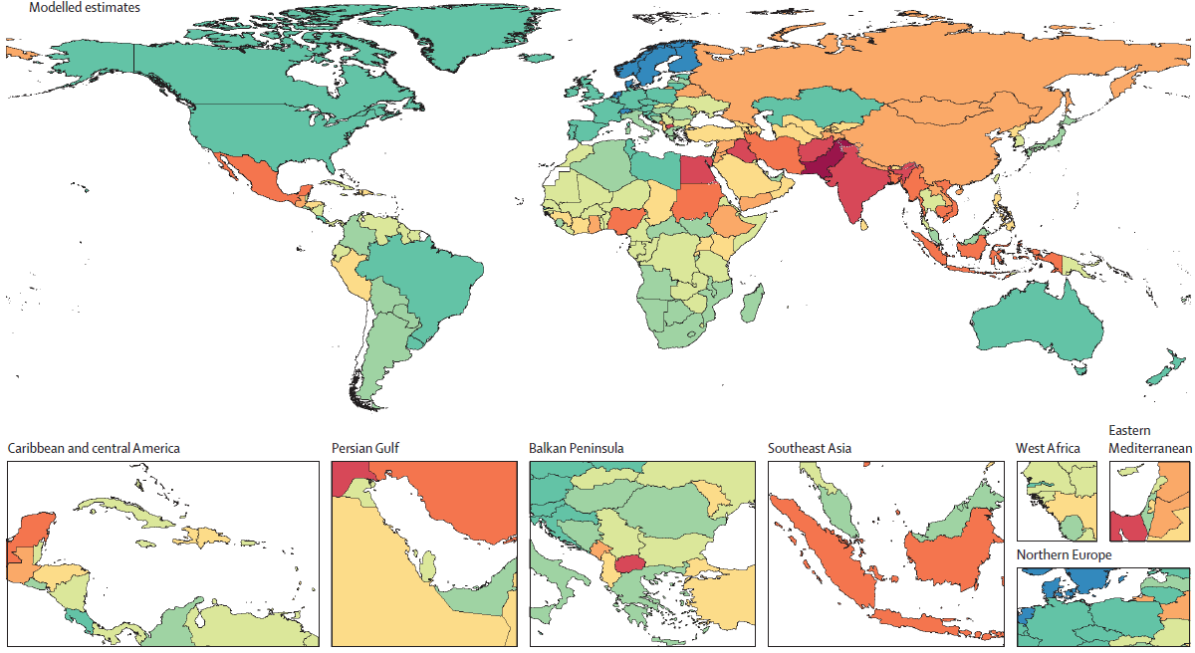
Global burden of bacterial antimicrobial resistance in 2019: a systematic analysis
3GCR- E.coli
Lancet
https://doi.org/10.1016/ S0140-6736(22)00087-3

Slide 12
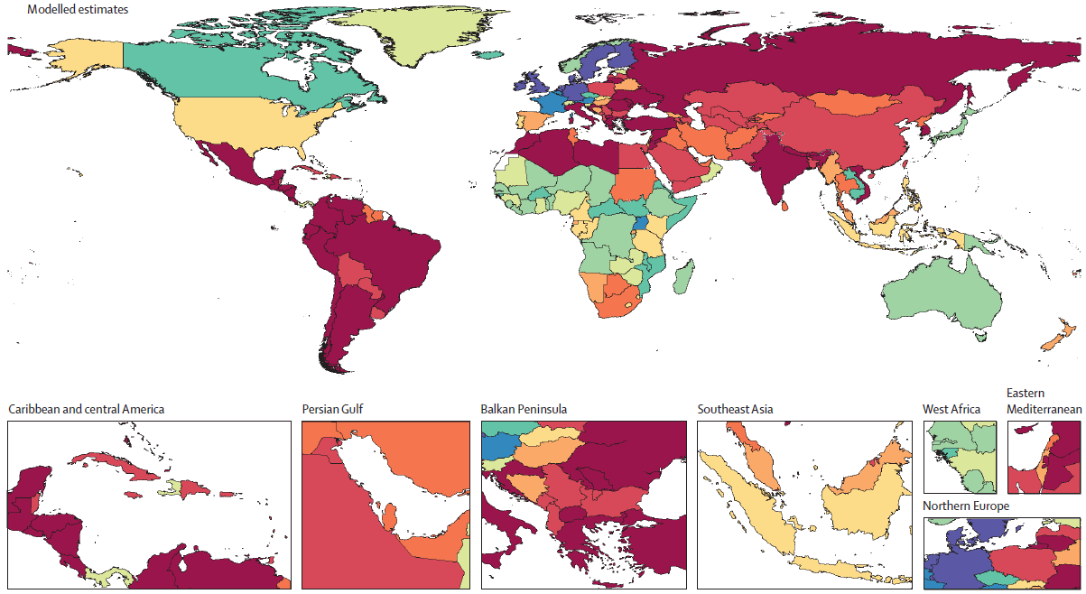
Global burden of bacterial antimicrobial resistance in 2019: a systematic analysis
Carbapenem-R A. baumannii
Lancet
https://doi.org/10.1016/ S0140-6736(22)00087-3

Slide 13
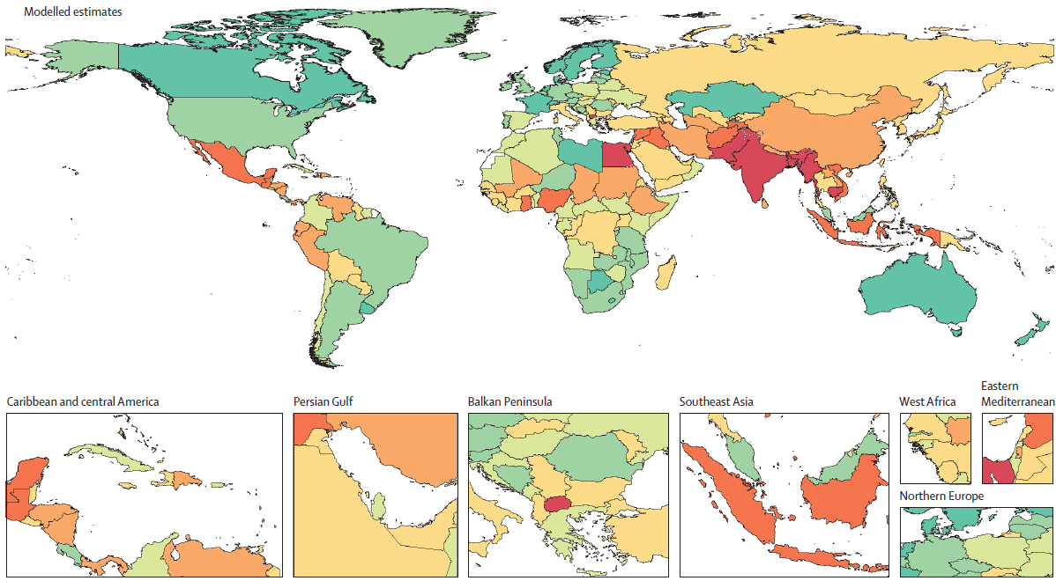
Global burden of bacterial antimicrobial resistance in 2019: a systematic analysis
FQ-R E. coli
Lancet
https://doi.org/10.1016/ S0140-6736(22)00087-3

Slide 14
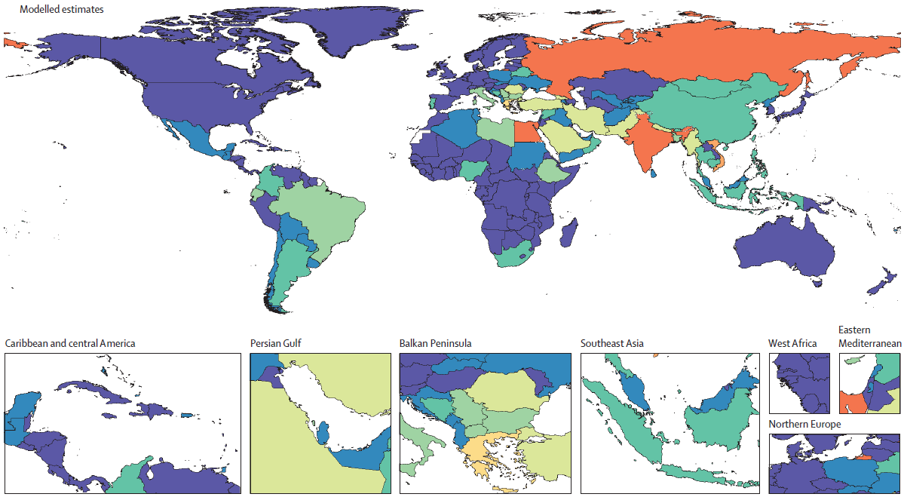
Global burden of bacterial antimicrobial resistance in 2019: a systematic analysis
Carbapenem-R K. pneumoniae
Lancet
https://doi.org/10.1016/ S0140-6736(22)00087-3

Slide 15
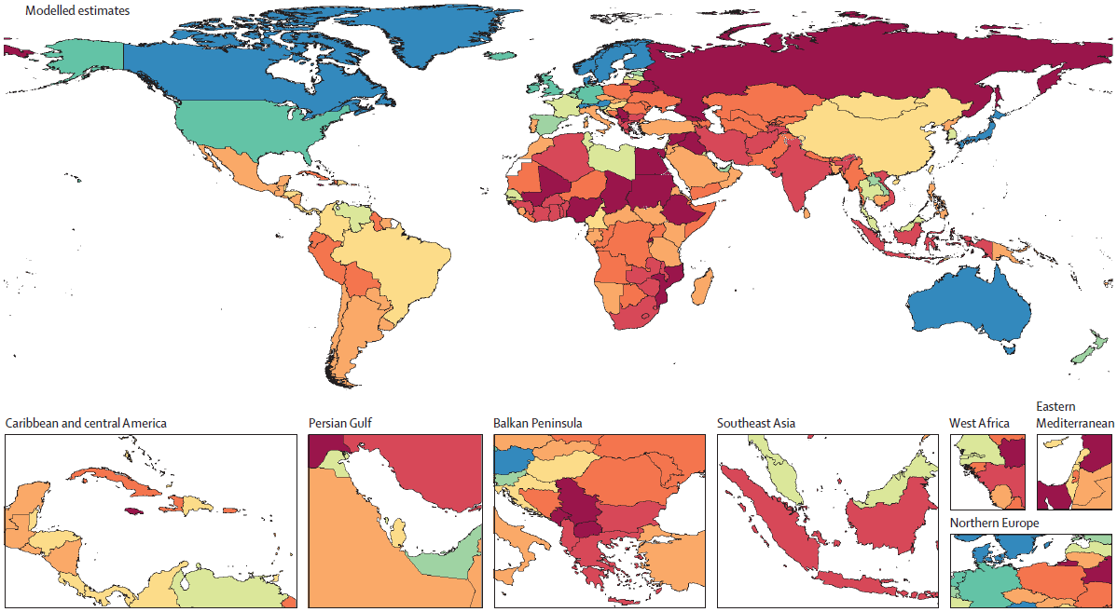
Global burden of bacterial antimicrobial resistance in 2019: a systematic analysis
3GCR K. pneumoniae
Lancet
https://doi.org/10.1016/ S0140-6736(22)00087-3

Slide 16
Global burden of bacterial antimicrobial resistance in 2019: a systematic analysis
Discussion:
If all drug-resistant infections were replaced by no infection, 4·95 million deaths could have been prevented → 3rd leading GBD cause of death ahead of ischaemic heart disease and stroke
if all drug-resistant infections were replaced by drug-susceptible infections, 1·27 million deaths could have been prevented → 12th leading GBD cause of death globally, ahead of both HIV and malaria
Resistance to fluoroquinolones and β-lactam antibiotics for more than 70% of deaths attributable to AMR across pathogens
Intervention strategies:
Infection prevention and control cornerstone in combating the spread of AMR;
Preventing infections through vaccinations is paramount for reducing the need for antibiotics
Reducing exposure to antibiotics unrelated to treating human disease
Minimising the use of antibiotics when they are not necessary to improve human health
Maintaining investment in the development pipeline for new antibiotics
Lancet
https://doi.org/10.1016/ S0140-6736(22)00087-3

Slide 17
Global burden of bacterial antimicrobial resistance in 2019: a systematic analysis
Discussion:
The highest rates of death were in sub-Saharan Africa and south Asia.
High bacterial AMR burdens are a function
Prevalence of resistance
Underlying frequency of critical infections (LRTI, BSI, intra-abdominal infections) higher in these regions
Scarcity of laboratory infrastructure
Inappropriate use of antibiotics driven by insufficient regulations and ease of acquisition,
Inadequate access to second-line and third-line antibiotics,
Counterfeit or substandard antibiotics that can drive resistance,
Poor sanitation and hygiene.
An increase in access to antibiotics would decrease the AMR burden in western sub-Saharan Africa
Limiting access to antibiotics through stewardship programmes might be appropriate in south Asia
Some of our estimates might be unexpected and deserve special attention, particularly the high burden in sub-Saharan Africa and the burden of carbapenem resistant A baumannii.
A baumannii, we estimated that it was the fourth leading pathogen–drug combination globally → strongly influenced by this higher relative burden in south Asia and other LMICs
Lancet
https://doi.org/10.1016/ S0140-6736(22)00087-3

Slide 18
Global burden of bacterial antimicrobial resistance in 2019: a systematic analysis
Limitations:
Sparsity of data from many LMICs on the distribution of pathogens by infectious syndrome, the prevalence of resistance for key pathogen–drug combinations, and the number of deaths involving infection; and the severe scarcity of data linking laboratory results to outcomes such as death
Strong assumptions: single relative risk for all infectious syndromes → overestimation. Relative risk of death or length of stay for infection from an MDR organism was assumed to be equal to the highest individual relative risk among the drugs assessed; Clinical bacteriology in LMICs
Several potential sources of bias we noted when combining and standardising data from a wide variety of providers → misclassification
No universal laboratory standard exists to demarcate resistance versus susceptibility
Selection bias in passive microbial surveillance data, particularly if cultures are not routinely drawn
Conclusion:
Efforts to build laboratory infrastructure
Expand AMR research to evaluate the indirect effects of AMR (effect of AMR on perioperative prophylaxis or prophylaxis of infections in transplant recipients, the effects of AMR on transmission, the impact of specific variants through genotypic epidemiology).
Identifying strategies that can work across a wide range of settings or those that are specifically tailored to the resources available and leading pathogen–drug combinations in a particular setting—is an urgent priority.
Lancet
https://doi.org/10.1016/ S0140-6736(22)00087-3

