Slide 1
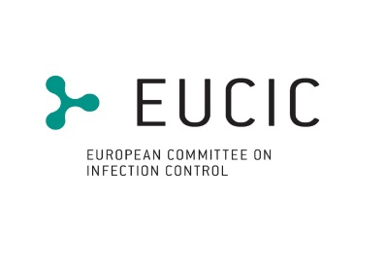
Special review
By Gabriel Birgand

Slide 2
An upper bound on one-to-one exposure to infectious human respiratory particles
Research questions:
What is the upper bound on SARS-CoV-2 infection risk for near-field exposure?
How does this upper bound change with the respiratory activities, that is, passive breathing vs. talking?
How does this upper bound vary with the exposure duration?
How do the type of face mask and the way it fits to the face affect the upper bound?
Which intervention strategy, between masking and social distancing, is most effective?
Methods:
Analysis of comprehensive database on respiratory particle size distribution;
Exhalation flow physics;
Leakage from face masks of various types and fits measured on human subjects;
Ambient particle shrinkage due to evaporation;
Rehydration, inhalability, and deposition in the susceptible airways
Gholamhossein Bagheria PNAS
https://doi.org/10.1073/pnas.2110117118

Slide 3
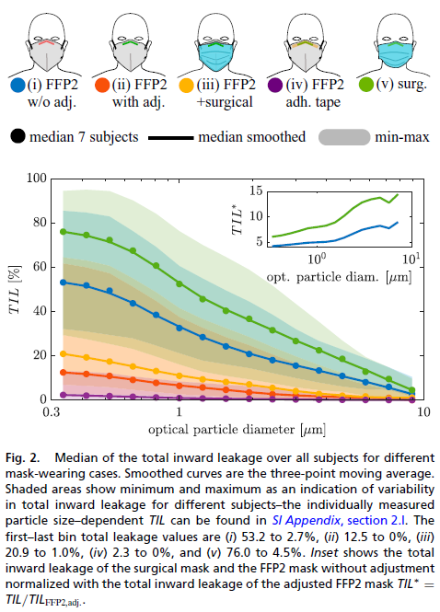
An upper bound on one-to-one exposure to infectious human respiratory particles
TIL Total inward (and outward) leakage
•
FFP2 mask: without any adjustment → total inward leakage of 53% for smallest particle (0.3 μm to 0.37 μm), 16% for 3 μm.
Improvement of TIL by a factor of 4.3 on small particles and 7.5 on 3 μm particles by simply adjusting the mask nosepiece to the nose
Surgical mask: highest total inward leakage, max of 70% for smallest particle
TIL improved by a factor of 4 when adjusted
TIL 6 times higher compared to the adjusted FFP2 mask for the smallest particles and over 12 times higher for particles of>3 μm
Reading with loud voice (∼ 80 dBA to 90 dBA) decrease the TIL as compared to breathing through the nose by factor of 3 for the adjusted FFP2 mask
Thus, a better-fitting mask has a higher relative protection from large particles compared to small particles.
Gholamhossein Bagheria PNAS
https://doi.org/10.1073/pnas.2110117118

Slide 4
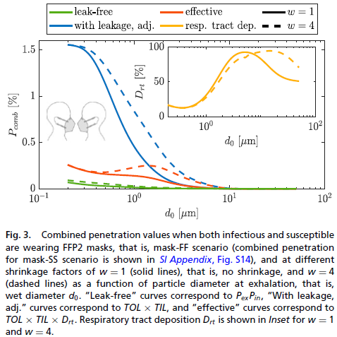
An upper bound on one-to-one exposure to infectious human respiratory particles
Effective Respiratory Tract Penetration
The deposition fraction in different regions of the respiratory tract behaves differently particle shrinkage
Impact of shrinkage factor (w) is more visible for the leak-included than leak-free penetration.
Combined penetration for FFP2 masks with leakage increases with particle shrinkage factor, since large particles that penetrate through the mask of infectious have higher penetration probability through the mask of susceptible as they get smaller by a factor of w.
Increases the inhalability probability of particles with initial wet diameter of >7 μm.
Particles with wet diameters of 1 μm to 3 μm would have about 10% lower probability of deposition when w = 4 (shrinkage ratio)
For w = 4, the maximum penetration occurs for ∼ 1.5-μm particles, whereas, in case of no shrinkage (i.e., w = 1), the maximum penetration occurs for the smallest particle size.
Gholamhossein Bagheria PNAS
https://doi.org/10.1073/pnas.2110117118

Slide 5
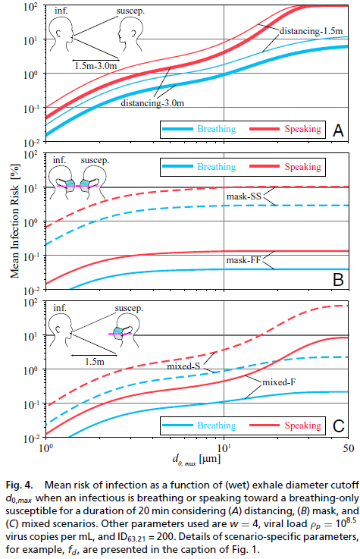
An upper bound on one-to-one exposure to infectious human respiratory particles
Exposure/Infection Risk for COVID-19
5-μm cutoff, the typical cutoff size for aerosols
A scenario: Distancing without mask
Increasing distancing from 1.5 m to 3.0 m reduces risk of infection when infectious is breathing but not for a speaking infectious, but universal masking is an extremely effective
B scenario: both infectious and susceptible wear FFP2 masks
A reduction in the risk of infection by a factor of ∼ 75
C scenario: only the susceptible adheres to masking
Even when they are distancing, the probability of infection risk can be as high as ∼10% if the susceptible wears an adjusted FFP2 mask, or ∼70% if the susceptible wears a surgical mask while in the exhalation cone of a speaking infectious.
An adjusted FFP2 mask reduces risk of infection by about a factor of 10 compared to an adjusted surgical mask, independent of the infectious activity
Difference between A and B scenario:
The reason for such a significant deviation between breathing and speaking is the increased probability of producing >10 μm for vocalization-associated activities, this deviation in the trend disappears for masking scenario
Gholamhossein Bagheria PNAS
https://doi.org/10.1073/pnas.2110117118

Slide 6
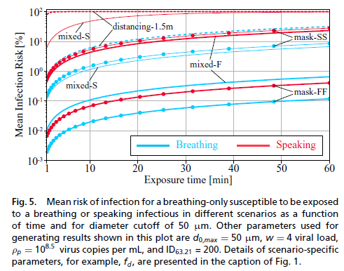
An upper bound on one-to-one exposure to infectious human respiratory particles
Risk of infection as a function of exposure duration
The distancing scenarios quickly becomes unsafe, already after about 1.5 min for a speaking infectious,
The risk of infection for the susceptible at a distance of 1.5 m is 90%.
All the speaking infectious scenarios with the exception of mask-FF bypass the 1% threshold within a few minutes and reach>10% in 1 h.
The only breathing infectious scenario associated with >10% infection risk in 1 h is the distancing-1.5m scenario.
The safest scenarios that stay below the 1%threshold for 1 h of exposure in order of best to worse are mask-FF for breathing and speaking infectious, respectively, followed by the mixed-F with a breathing infectious.
Gholamhossein Bagheria PNAS
https://doi.org/10.1073/pnas.2110117118

Slide 7
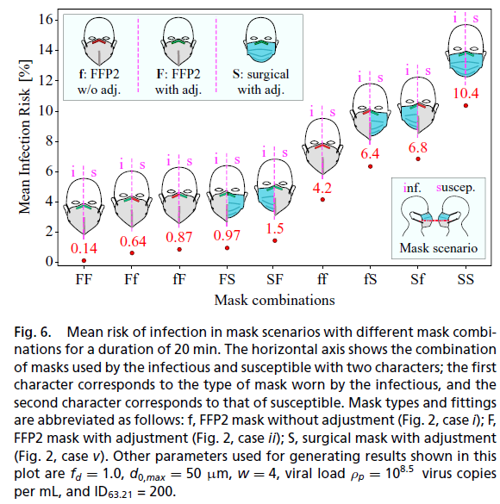
An upper bound on one-to-one exposure to infectious human respiratory particles
F: with nosepiece adjustments and f: without nosepiece adjustments
Different combinations of mask fittings
Best preventive measure is an adjusted FFP2 mask (case FF) for both infectious and susceptible,
Least safe measure is for both to wear a surgical mask (case SS).
Very loosely fitted FFP2 masks (case ff) outperform adjusted surgical masks (case SS) by a factor of 2.5.
Proper nosepiece adjustment for FFP2 masks can decrease risk of infection by a factor of 30 (case FF vs. case ff),
If at least one of the infectious or susceptible adjust their FFP2 masks, the increase in risk compared to case FF is about 5 to 7 times.
Risk of infection for asymmetric cases, that is, Ff vs. fF, FS vs. SF, and fS vs. Sf, is lower by about 7 to 50% when the better mask or the better-adjusted mask is worn by the infectious.
Masks are more effective outwardly (protection of third parties).
Gholamhossein Bagheria PNAS
https://doi.org/10.1073/pnas.2110117118

Slide 8
An upper bound on one-to-one exposure to infectious human respiratory particles
Conclusions
Social distancing alone without masking is associated with a very high risk of infection, especially where infectious is speaking.
High infection risks are also expected when only the susceptible wears a face mask, even with social distancing.
Universal masking is the most effective method for limiting airborne transmission of SARSCoV-2, even when face seal leaks are considered.
The main factor affecting infection risk in the universal masking scenario is leakage between the mask and the face.
Fitted FFP2 masks to infectious and susceptible faces, can reduce the risk of infection by a factor of 30 compared with loosely worn masks and by a factor of 75 compared with fitted surgical masks for an exposure duration of 20 min.
The use of FFP2 masks should be preferred to surgical masks, as even loosely worn FFP2 masks can reduce the risk of infection by a factor of 2.5 compared with well-fitted surgical masks.
Universal masking with surgical masks and/or FFP2 masks is a very effective measure to minimize the transmission of COVID-19.
Gholamhossein Bagheria PNAS
https://doi.org/10.1073/pnas.2110117118

